Slide 1
System Software and Compiler Design
BCSSS602
3:0:2

Slide 2
Pre- requisites
Computer Organization
Any programming language
Data Structures
Automata Theory

Slide 3
Course Learning Objectives (CLO)
Understand the phases of the compiler
Generate parse table, Intermediate Code, and Target Code
Learn the concepts of System software – Assemblers and Loaders

Slide 4
MODULE 5
Assembler
Machine Dependent Assembler Functions
Introduction to loaders
Basic Loader Functions
Machine Dependent Loader Functions
Machine Independent Loader Functions

Slide 5
Machine Dependent Assembler Functions
Instruction Formats and Addressing Modes
SIC/XE
PC-relative/Base-relative addressing op m
Indirect addressing op @m
Immediate addressing op #c
Extended format +op m
Index addressing op m, X
register-to-register instructions COMPR
larger memory → multi-programming (program allocation)

Slide 6
Translation
Register translation
register name (A, X, L, B, S, T, F, PC, SW) and their values (0,1, 2, 3, 4, 5, 6, 8, 9)
preloaded in SYMTAB
Address translation
Most register-memory instructions use program counter relative or base relative addressing
Format 3: 12-bit address field
base-relative: 0~4095
pc-relative: -2048~2047
Format 4: 20-bit address field

Slide 7
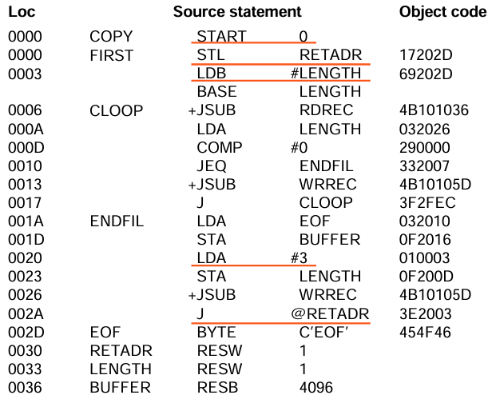
Instruction Formats & Addressing Modes
Consider the code;

Slide 8
Instruction Formats & Addressing Modes
START statement
5 COPY START 0
Here -
COPY is the program name
START - directive that specifies a beginning program with address 0
it is a relocatable program, treated as if the program is loaded starting at address 0

Slide 9
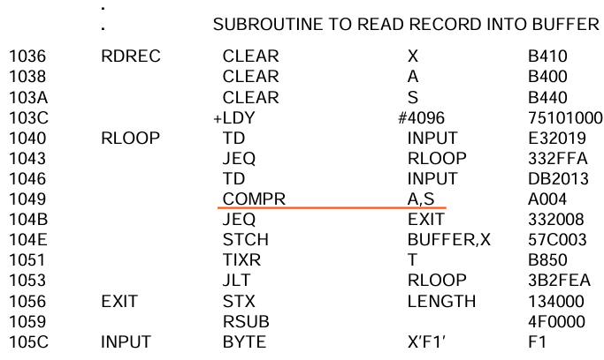

Slide 10
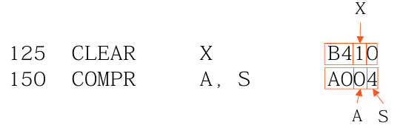
Register-register instruction
Convert the mnemonic name to their number equivalents
Register name (A, X, L, B, S, T, F, PC, SW) and their values (0,1, 2, 3, 4, 5, 6, 8, 9)
May implement in a separate table or preload the register names and values to SYMTAB

Slide 11
Address translation
Most register-memory instructions use program counter relative or base relative addressing
Format 3: 12-bit address field
base-relative: 0~4095
pc-relative: -2048~2047
Format 4: 20-bit address field

Slide 12
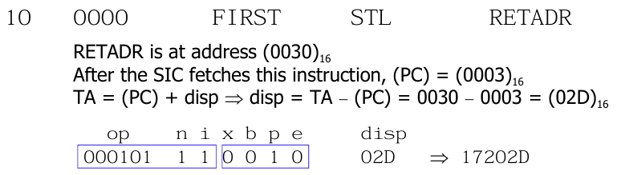
Program counter relative
Calculate displacement
Displacement must be small enough to fit in a 12-bit field (-2048..2047 )
In SIC, PC is advanced after each instruction is fetched and before it is executed; i.e., PC contains the address of the next instruction.

Slide 13
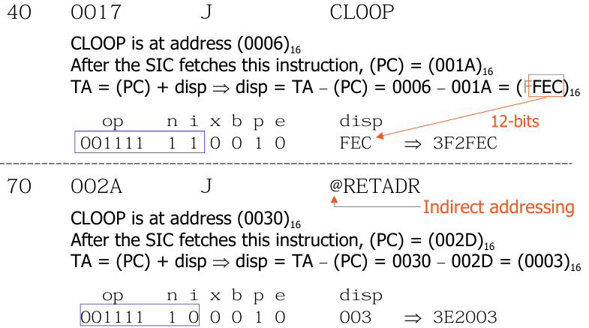
Program counter relative

Slide 14
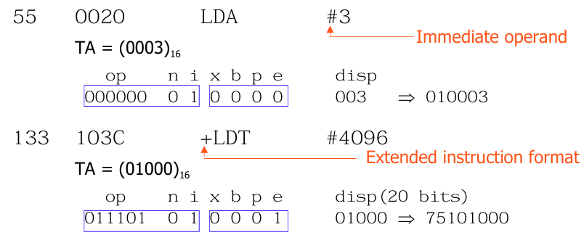
Immediate addressing
No memory reference is involved
If immediate mode is specified, the target address becomes the operand

Slide 15
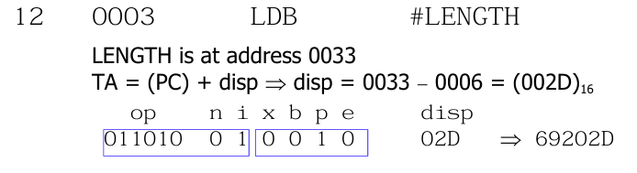
Immediate & PC-relative addressing

Slide 16
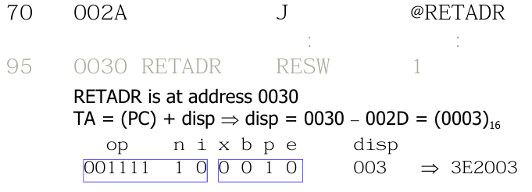
Indirect & PC-relative addressing

Slide 17
Data structures of Assembler
The simple assembler uses two major internal data structures: the operation Code Table (OPTAB) and the Symbol Table (SYMTAB).
OPTAB
OPTAB is a static table.
OPTAB contains the mnemonic operation code and its machine language equivalent
In more complex assemblers, OPTAB also contains information about instruction format and length.
OPTAB is usually organized as a hash table, with mnemonic operation code as the key .

Slide 18
Data Structures of Assembler
SYMTAB
includes the name and value (address) for each label in the source program , together with flags to indicate error conditions ( e.g,. a symbol defined in two different places ).
This table may also contain other information about the data area or instruction labeled – for example , its type or length.
SYMTAB is usually organized as a hash table for efficiency or insertion and retrieval.

Slide 19
LOCCTR: this is another important variable which helps in the assignment of the addresses.
LOCCTR is initialized to the beginning address mentioned in the START statement of the program.
After each statement is processed, the length of the assembled instruction is added to the LOCCTR to make it point to the next instruction.
Whenever a label is encountered in an instruction the LOCCTR value gives the address to be associated with that label.

Slide 20
Program Relocation
The need for program relocation
It is desirable to load and run several programs at the same time.
The system must be able to load programs into memory wherever there is room.
The exact starting address of the program is not known until load time.
Problem with Absolute Program
Program with starting address specified at assembly time
The address may be invalid if the program is loaded into somewhere else

Slide 21
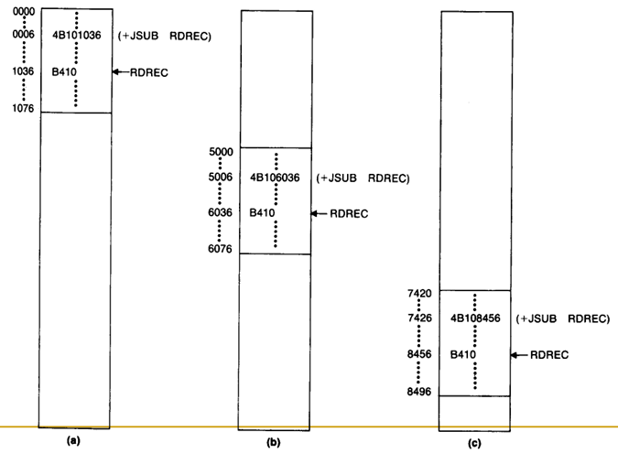

Slide 22
The way to solve the relocation problem
For an address label, its address is assigned relative to the start of the program(START 0)
Produce a Modification record to store the starting location and the length of the address field to be modified.
The command for the loader must also be a part of the object program.

Slide 23
Object code Generation - SIC
Generate the object program for the SIC program.
Given: LDA=00, LDX=04, ADD=18,
TIX=2C, JLT=38, STA=0C, RSUB = 4C
8 1 15
LABEL | MNEMONIC | OPERAND
SUM | START | 4000
FIRST | LDX | ZERO
 | LDA | ZERO
LOOP | ADD | TABLE, X
 | TIX | COUNT
 | JLT | LOOP
 | STA | TOTAL
 | RSUB | -
TABLE | RESW | 2000
COUNT | RESW | 1
ZERO | WORD | 0
TOTAL | RESW | 1
 | END | FIRST
OPCODE X ADDRESS

Slide 24
LOCATION | LENGTH | LABEL | MNEMONIC | OPERAND | OBJECT CODE
 | 3 | SUM | START | 4000
4000 | 3 | FIRST | LDX | ZERO | 045788
4003 | 3 |  | LDA | ZERO | 005788
4006 | 3 | LOOP | ADD | TABLE, X | 18C015
4009 | 3 |  | TIX | COUNT | 2C5785
400C | 3 |  | JLT | LOOP | 384006
400F | 3 |  | STA | TOTAL | 0C578B
4012 | 3 |  | RSUB | - | 4C0000
4015 | 3 x 2000 = 1770H | TABLE | RESW | 2000 | -
5785 | 3 | COUNT | RESW | 1 | -
5788 | 3 | ZERO | WORD | 0 | 000000
578B | 3 | TOTAL | RESW | 1 | -
578E |  |  | END | FIRST
LDA=00 LDX=04 ADD=18 TIX=2C JLT=38 STA=0C RSUB = 4C

Slide 25
Object program generation
Header record: Contains the program name, starting address and length.
Text record: Contains the machine code and data of the program.
End record: Marks end of object program and specifies the address in the program where execution is to begin
H^SUM---^004000^00178E
T^004000^15^045788^005788^18C015^2C5785^384006^0C578B^4C0000
T^005788^03^000000
E^004000
Instead of two Text records, last object code can be included in the first T line itself and instead of 15, 18 should be the length
178E = (End address – start address 578E – 4000)
15 = 7 object codes, each 3 bytes – 7x3 = 21 = 15H

Slide 26
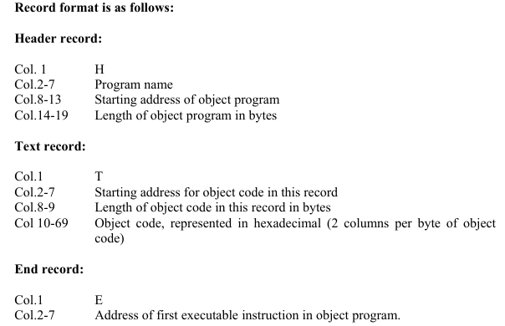

Slide 27
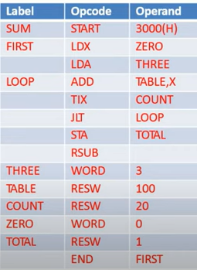
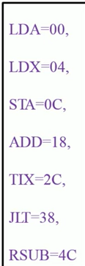

Slide 28
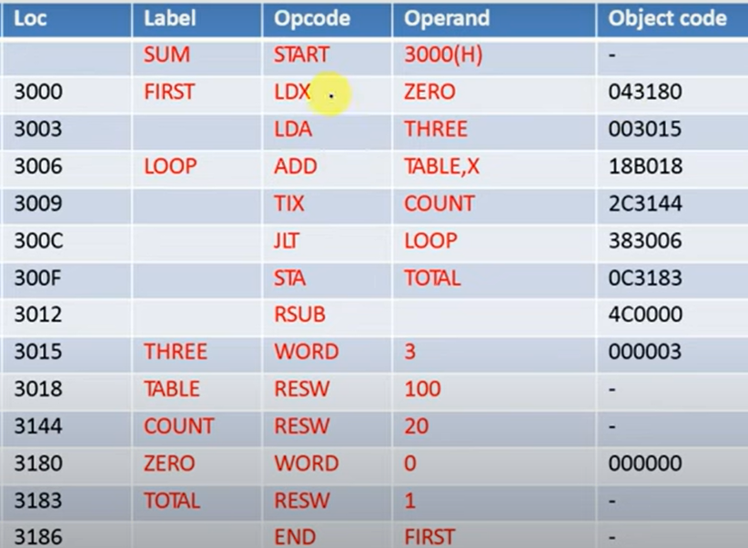

Slide 29
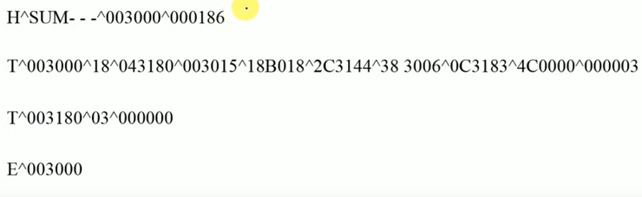
Object program

Slide 30
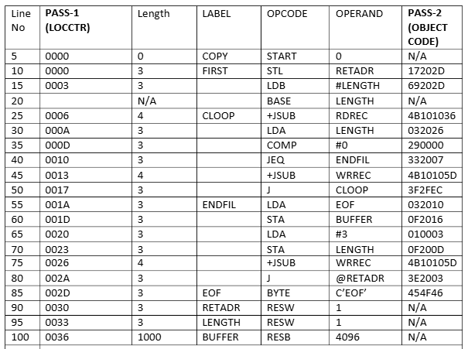
COPY START 1000
FIRST STL RETADR
LDB #LENGTH
BASE LENGTH
+JSUB RDREC
LDA LENGTH
COMP ZERO
JEQ ENDFIL
+JSUB WRREC
J FIRST
ENDFIL LDA EOF
STA BUFFER
LDA #3
STA LENGTH
JSUB WRREC
J ENDFIL
RETADR RESW 1
LENGTH RESW 1
ZERO WORD 0
EOF BYTE C'EOF'
BUFFER RESB 4096
END FIRST

Slide 31
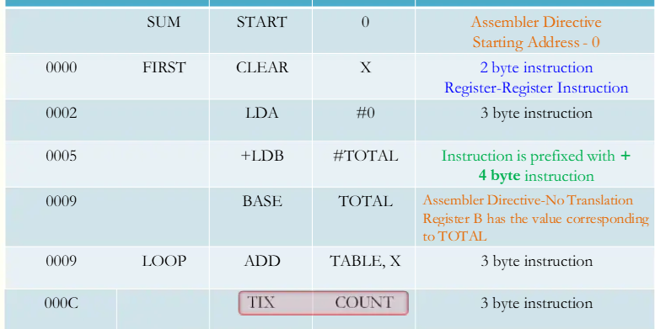
Object code Generation – SIC/XE

Slide 32
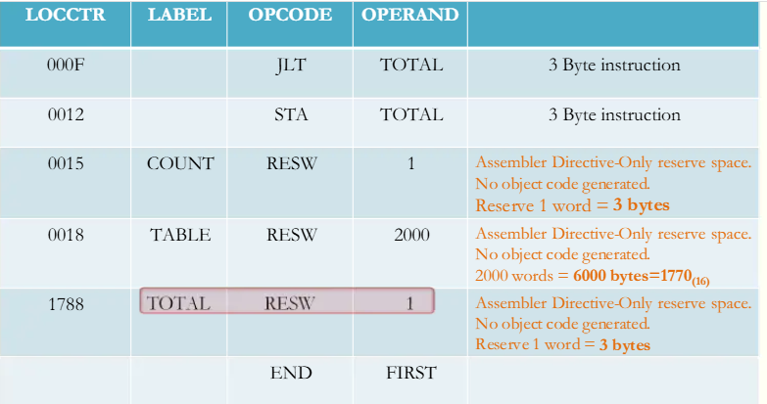

Slide 33
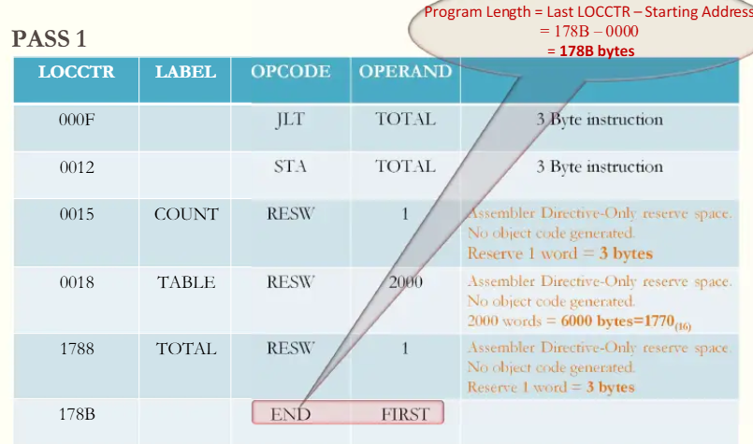

Slide 34
Assembler Directive- so, no opcode

Slide 35
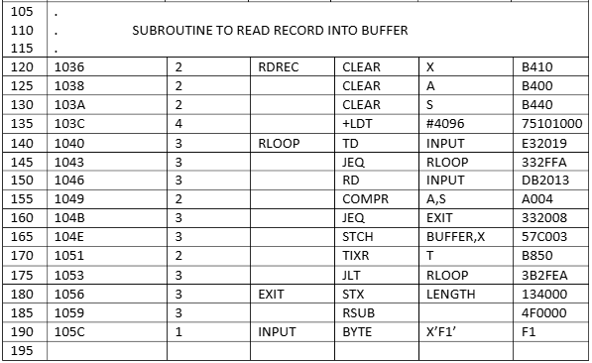

Slide 36
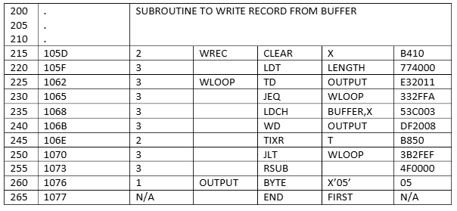

Slide 37
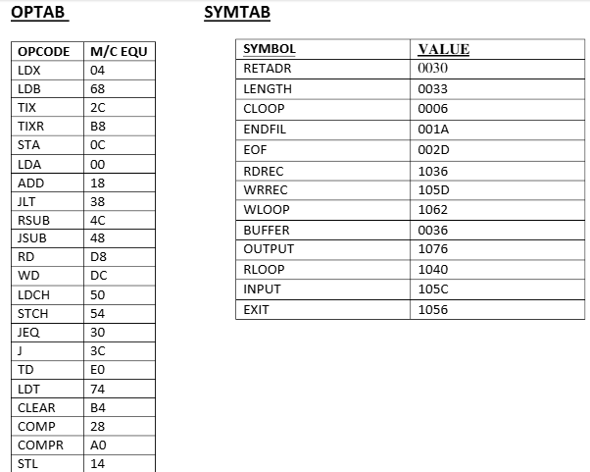

Slide 38
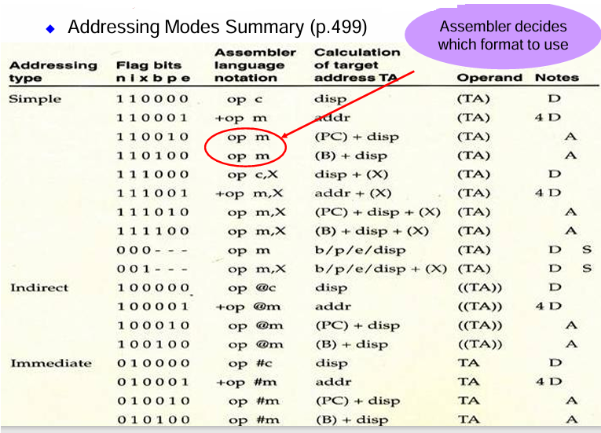

Slide 39
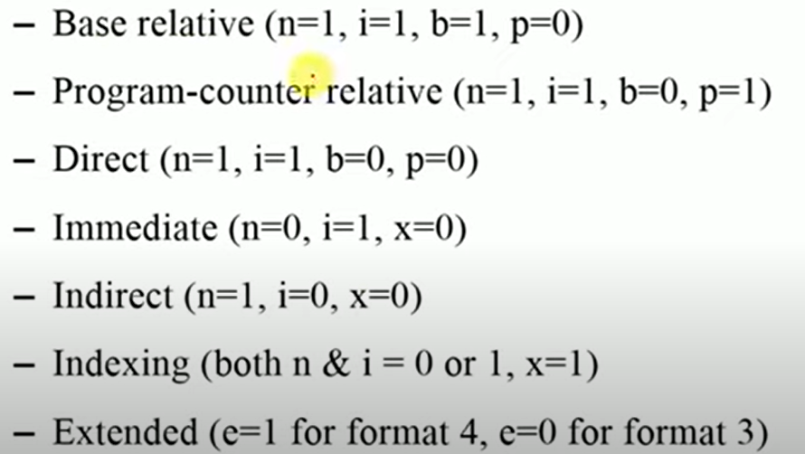

Slide 40
Object code for each instruction
10 | 0000 | 3 | FIRST | STL | RETADR | 17202D
This is PC relative addressing as L (link Register) is used
STL = 14 DISP = TA – PC = 0030 – 0003 = 2D
OPCODE | n | i | x | b | p | e | DISP
01 0100 | 1 | 1 | 0 | 0 | 1 | 0 | 0000 0010 1101
14 + 3 = 17 |  |  | 2 |  |  |  | 0 2 D

Slide 41
Object code for each instruction
15 | 0003 | 3 |  | LDB | #LENGTH | 69202D
This is PC relative addressing and immediate addressing
LDB = 68 DISP = TA – PC = 0033 – 0006 = 2D
OPCODE | n | i | x | b | p | e | DISP
01101000 | 0 | 1 | 0 | 0 | 1 | 0 | 0000 0010 1101
68 + 1 = 69 |  |  | 20 |  |  |  | 0 2 D

Slide 42
Object code for each instruction
25 | 0006 | 4 | CLOOP | +JSUB | RDREC | 4B101036
This is Extended Addressing ( +) and immediate addressing
JSUB = 48 DISP = RDREC = 1036
OPCODE | n | i | x | b | p | e | DISP
01001000 | 1 | 1 | 0 | 0 | 0 | 1 | 0000 0001 0000 0011 0110
48 + 3 = 4B |  |  | 1 |  |  |  | 0 1 0 3 6

Slide 43
Object code for each instruction
30 | 000A | 3 |  | LDA | LENGTH | 032026
This is Direct Addressing with PC relative, because the displacement
LDA = 00 DISP = 0033 – 000D = 0026
OPCODE | n | i | x | b | p | e | DISP
0000 0000 | 1 | 1 | 0 | 0 | 1 | 0 | 0000 0010 0110
00 + 3 = 03 |  |  | 2 |  |  |  | 026

Slide 44
THANK YOU

